Slide 1

Intelligent Retail Webinar
April 30, 2020
Microsoft + Intel

Slide 2




Speakers
Raechel Frick
Dianne Lamendola
Ricardo Mendes
George Moore
Intel
Market Development Manager
Intel
Global Partner Executive
Microsoft
Principle Program Manager
Microsoft
CTO Azure Global Engr

Slide 3
Agenda
Introduction
Retail Overview
Accelerating Retail Insights
Azure Stack Edge + Hub Overview
Intelligent Retail Blueprint Overview

Slide 4

Imagine if…
You could predict every purchase your customer will make in the next six months.
Empowering store employees with data to instantly recognize a customer and hand them products before they even know they want them.
Delighting customers with lightning-fast fulfillment and real-time flexible delivery enabled by an efficient supply chain.
New retail store models that enable real-time personalized recommendations, click and collect, and in-store digital assistants.
© Copyright Intel and Microsoft Corporation. All rights reserved.

Slide 5
Retail Overview

Slide 6
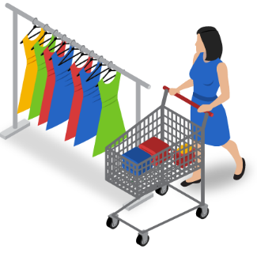
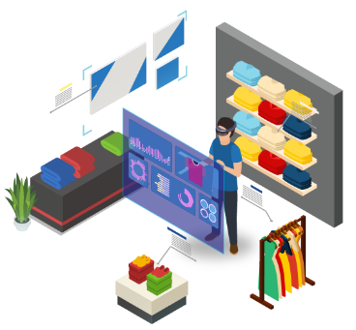
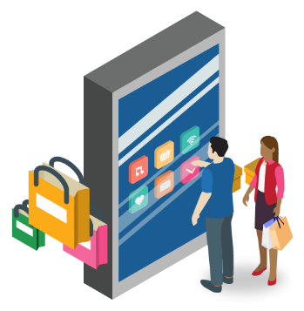

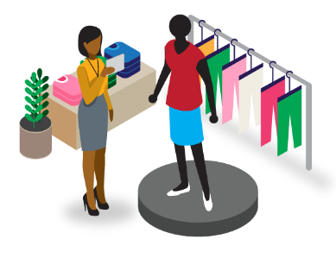
Enabling Intelligent Retail
Your customers. Your employees. Your data.
Azure Synapse (Connecting Data and AI)
Know your customers
Empower your employees
Deliver intelligent supply chain
Reimagine retail
Be prepared
Enable customer first retail
Enable your brand ambassadors to delight your customers
Close the gap between demand and fulfillment to delight your customers
Imagine the impossible and then make it happen
Flexibility to react to new customer needs

Slide 7
Superpowers for edge to cloud
Scale & flexibility
Local processing for blaze fast inferencing
Deliver a highly customized experiences with Microsoft Azure and Intel architecture
Edge to cloud data transfer for insights aggregation across different locations

Slide 8




Essentials
COVID-19: A Blip Or A New Normal?
COVID-19
Non-Essentials

Slide 9
COVID-19: A Blip Or A New Normal?
 | Essentials | Non-essentials
 | Repurpose stores to focus on essential product lines and provide safe shopping | Temporary store closures and staff lay-offs (stores, distribution & supply chain)
 | Huge growth in demand driving investment in tech and people to meet demand | Driving shopper to on-line with discounts to keep some revenues flowing
Stores
Online

Slide 10
Some early trends emerging
 | Contactless Solutions | Optimized IT
 | Stores as Order Fulfillment Hubs | Health Monitoring
 | Remote Capabilities | Supply Chain Automation & Agility

Slide 11
Accelerating Retail Insights

Slide 12
Enabling Intelligent Retail
Your customers. Your employees. Your data.
Azure Synapse (Connecting Data and AI)
Know your customers
Empower your employees
Deliver intelligent supply chain
Reimagine retail
Be prepared
Enable customer first retail
Enable your brand ambassadors to delight your customers
Close the gap between demand and fulfillment to delight your customers
Imagine the impossible and then make it happen
Flexibility to react to new customer needs

Slide 13
Businesses are forced to maintain two critical, yet independent analytics systems
Big Data
Relational Data
Experimentation
Fast exploration
Semi-structured data
Proven security & privacy
Dependable performance
Operational data
Or
Data Lake
Data Warehouse

Slide 14
Azure brings these two worlds together, in a single service, to provide limitless analytics
Azure Synapse Analytics
Data warehousing & big data analytics—all in one service

Slide 15

BI + Analytics unlock the door to AI, machine learning, and real-time insights
How can we make it happen?
Prescriptive Analysis
What will happen?
Predictive Analysis
Optimization
Why did it happen?
Diagnostic Analysis
Value
What happened?
Descriptive Analysis
BI
Analytics
Information
Hindsight | Insight | Foresight
Difficulty
Gartner “IT Glossary_Predictive Analytics” http://www.gartner.com/it-glossary/predictive-analysis

Slide 16


Traditional Big Data Model: Separate services, little unification
Logs (unstructured)
Ingest
Store
Prep
Serve
Reporting
Media (unstructured)
Files (unstructured)
Azure Data Factory
Azure Data Lake Storage
Azure Databricks
Azure SQL Data Warehouse
Power BI
Business / custom apps (structured)

Slide 17



Microsoft Azure is the only cloud provider to unify AI, BI, and Analytics creating accelerated time-to-insight
Azure Machine Learning
On-premises data
Cloud data
Power BI
Devices data
Azure Synapse Analytics
SaaS data
Unified Store
Business
Automation
Azure Data Lake Storage

Slide 18
Data and Analytics Demo Scenario: Buy Online, Contactless Curbside Pickup
Buy Online
Store Execution
Curbside Pickup
E-commerce Analytics
Real-time Shelf Inventory
License Plate Recognition
Azure Synapse (Connecting Data and AI)

Slide 19
Demo

Slide 20
Azure Stack Hub + Edge

Slide 21

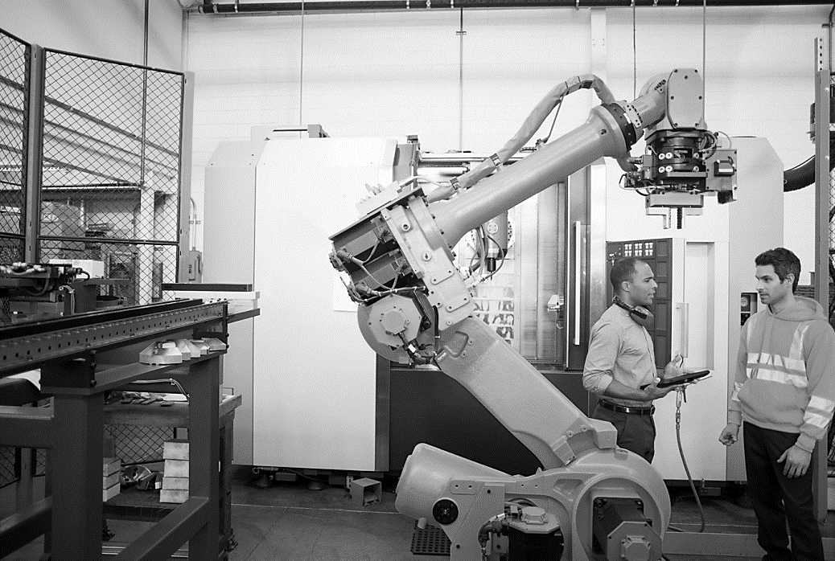
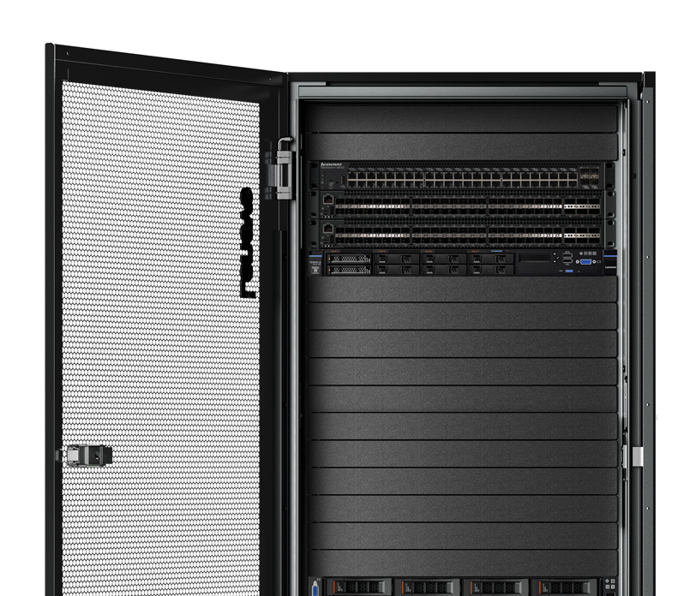
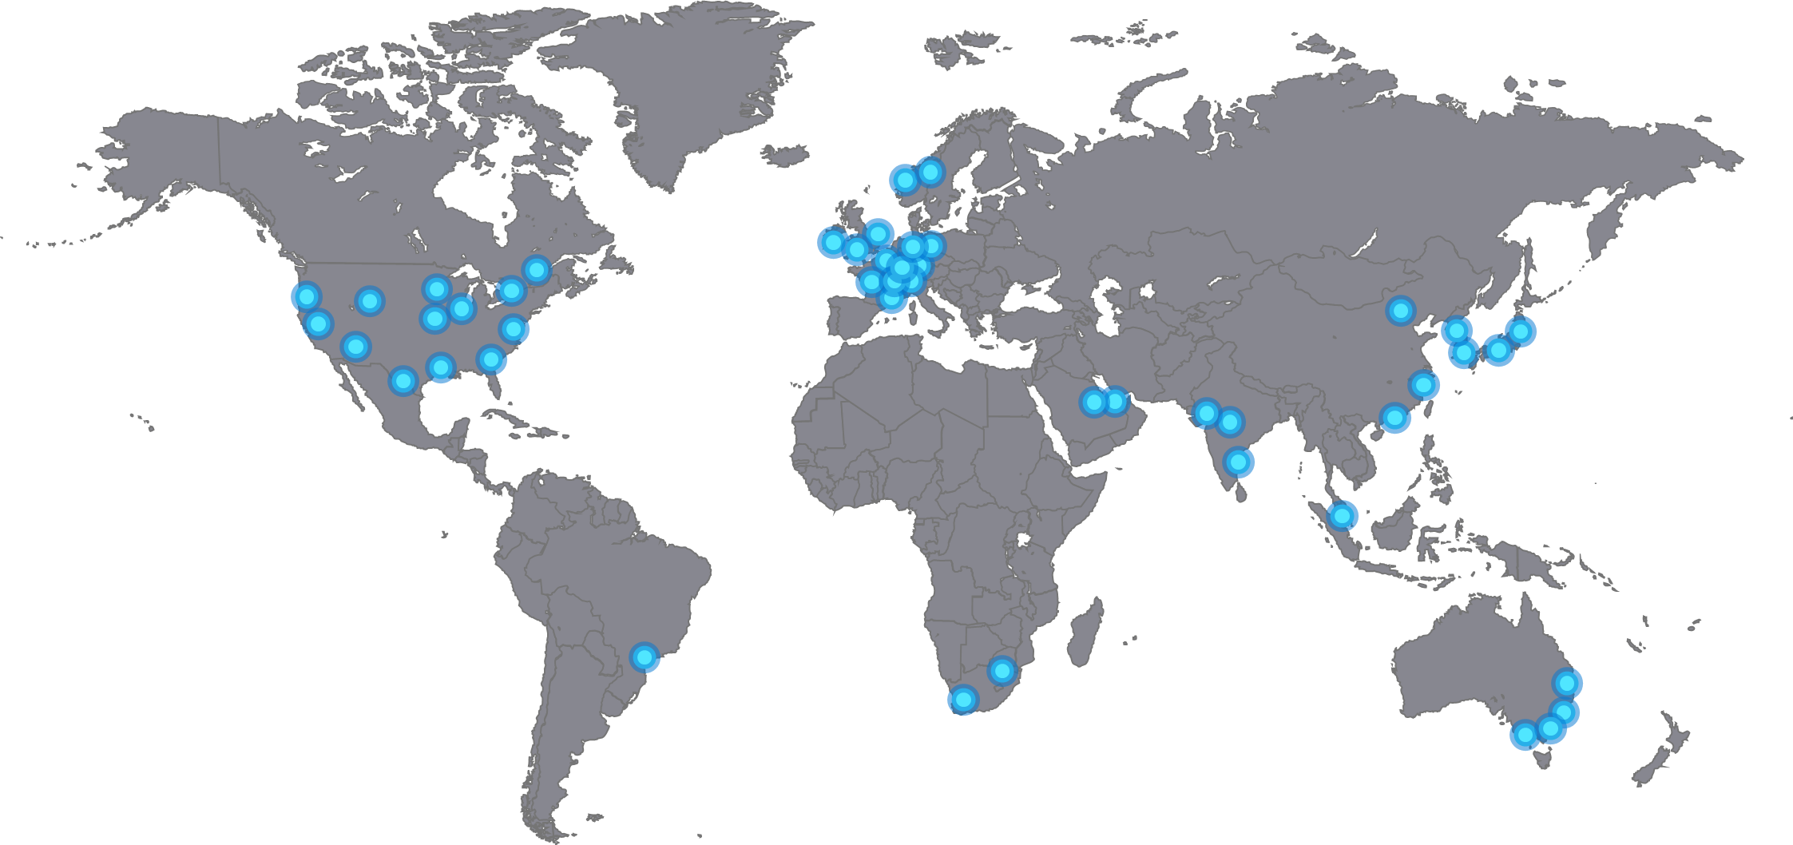
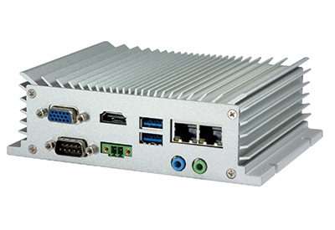
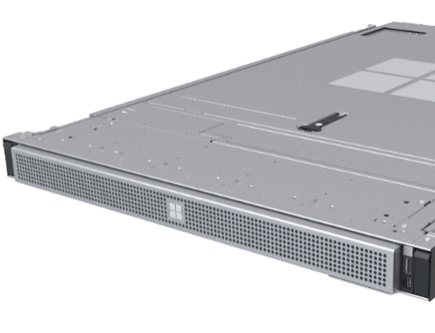
Intelligent Cloud & Intelligent Edge
Microcontroller Azure Sphere
Highly-secured, connected MCU
Azure Sphere Linux OS for modern MCUs
Azure Sphere Public Preview release in September 2018
Included Azure IoT Device SDK
IoT devices Azure IoT Device SDK
1000+ devices
250+ partners
All certified to work great with Azure IoT Hub
Edge devices Azure IoT Edge – Azure Stack HCI
Deploy and manage Azure Services in containers on any IoT device
AI, AzureML, Azure Stream Analytics and more
Generally available
Edge appliances Azure Stack Edge
Azure Stack Edge: AI-Enabled, Storage and compute Azure Edge appliance
Includes Azure IoT Edge
Data Box: Offline, ruggedized data transport, 100 TB – 1 PB
Hybrid cloud Azure Stack Hub
Cloud Consistent Edge
Edge and Disconnected Scenarios
Regulatory Requirements
Cloud app model on-premises
Hyperscale cloud Azure Regions
Full range Hyperscale Cloud Services
Tiered service availability: Heroes > Hubs > Satellites
Open Source based services & tools
Sensors + control
Sensors to interactive
Integrated platform
Global scale processing

Slide 22









Innovation anywhere with Azure
Azure Hybrid
Microsoft Azure
Microsoft Azure
Azure Stack
Azure Arc
Azure IoT
Integrated systems
Any datacenter, any cloud
Any edge device
Management | Security + Identity | App + Data Services | Dev Tools + DevOps

Slide 23
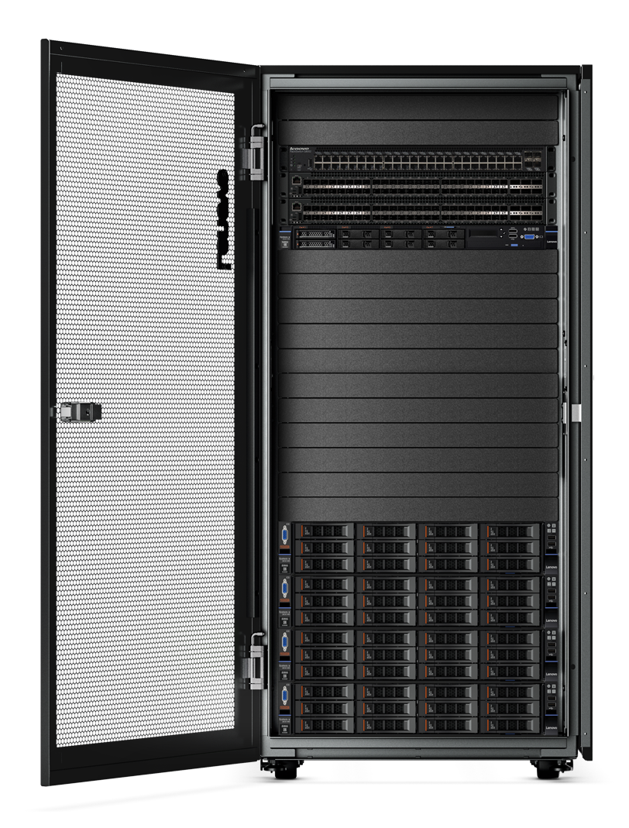
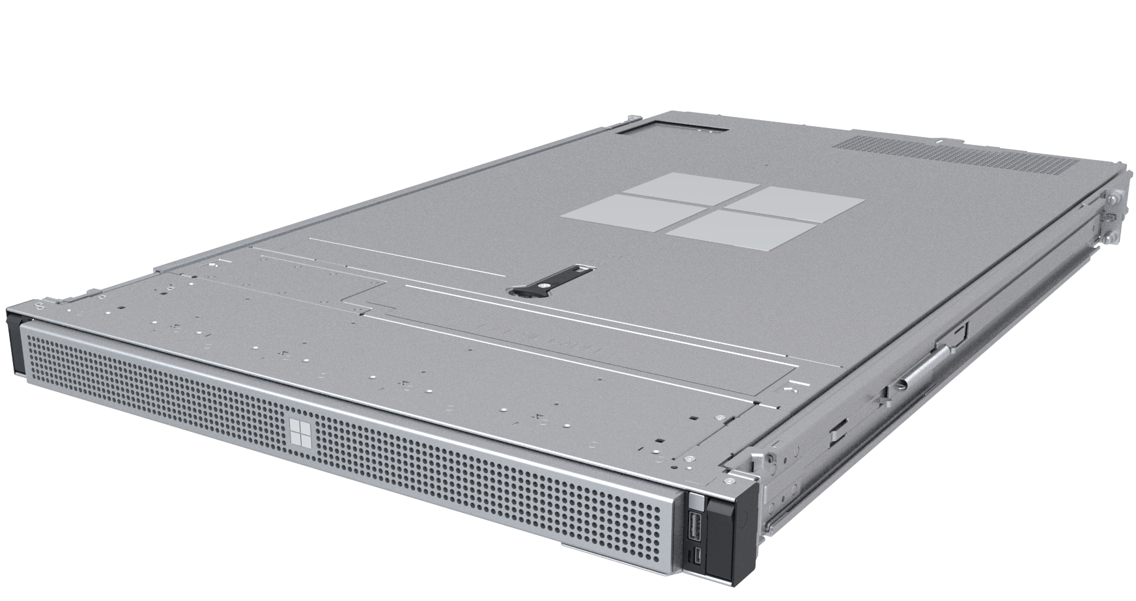
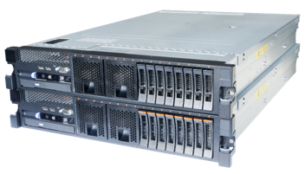
Consistently build and run hybrid apps across on-premises, cloud, and edge
Azure Stack portfolio
Azure Stack Edge
Cloud-managed appliance
Azure Stack HCI
Hyperconverged solution
Azure Stack Hub
Cloud-native integrated system
Machine learning at the edge
Edge compute and IoT solutions
Network data transfer to cloud
Scalable virtualization and storage
Remote branch office
High-performance workloads
Connected and disconnected
Data sovereignty
Application modernization

Slide 24
Azure Stack Hub
Complete autonomous cloud
Only consistent hybrid cloud that can run at the connected or disconnected
Azure connected or disconnected cloud
Consistent application development and operations
Common application model, tools and APIs with Azure simplifying DevOps
Regulatory & data sovereignty
Azure Services available on-premises
Azure web services, containers, Azure functions, and Azure marketplace
Application modernization
Purpose-built integrated system
Cloud inspired infrastructure via integrated systems from major H/W partners

Slide 25
Azure Stack Hub: An extension of Azure
Consistent application development
Azure services
available on-premises
Purpose-built
integrated system

Slide 26
Azure Stack Hub
Tools
Experiences
Deployments
Application patterns
Automations
Operations
Consistent application development
Azure services
available on-premises
Purpose-built
integrated system

Slide 27
Azure Stack Hub
Serverless
App Service
Containers
Marketplace
Virtual machines
Networking
Storage
Key Vault
Azure services
available on-premises
Consistent application development
Purpose-built
integrated system

Slide 28
Azure Stack Hub
Architecture, hardware, and topology
Deployment, configuration, provisioning
Validation
Monitoring, diagnostics
Security and privacy
Business continuity
Patching and updates
Field replacement of parts
Purpose-built
integrated system
Consistent application development
Azure services
available on-premises

Slide 29
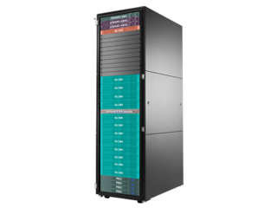
Azure Stack Hub
Ignite 2019 Announcements
Cognitive Services Public Preview
Kubernetes on Azure Stack with AKS engine
Azure Stack and DBE Hybrid Patterns (retail & auto labeling)
GPU Support – Private Preview
Fleet Management Private Preview 2020
Event Hubs Public Preview 2020
WVD Private Preview
Azure Data Services Private Preview
Azure Stream Analytics Public Preview
GPU-optimized form factor
Private Preview
BCDR Foundation Patterns

Slide 30

Coming Soon Azure Stack Hub GPU Support
Visualization Entry level desktops, graphics workloads
Machine Learning Training and Inferencing on the Edge
OPTIONS:
Partitioned (GPU-P)
NVv4 series VMs
AMD MI25
Passthrough (DDA)
VM Sizes TBD
NVIDIA T4
OPTIONS:
Passthrough only (DDA)
NCv3 VMs
NVIDIA V100
Learning, inference)
VM Sizes TBD
NVIDIA T4
Light learning, inference, visualization
Private Preview Available Now!
Signup at: https://aka.ms/azurestackhubgpupreview
Participation in the preview is limited to customers that already have GPU equipped stamps.

Slide 31
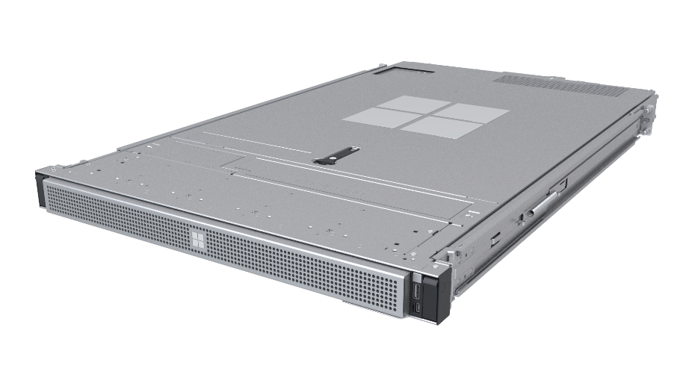
Azure Stack Edge
Hardware-accelerated machine learning
Accelerate ML inferencing using on-board FPGA or GPU to get results close to the data source
Machine learning at the edge
Edge compute
Run VMs, containers, and Azure services at the edge locations
Edge compute and IoT solutions
Azure managed appliance
Order and manage your appliance and workloads through the Azure portal
Network data transfer from edge to cloud
Cloud storage gateway
Transfer data to Azure over the network while retaining local access to blobs and files

Slide 32
Many Azure Services Offer Containerized Edge Versions
Azure Cognitive Services
Azure Machine Learning
Azure Stream Analytics
Azure Functions
SQL Database
Edge
Event Grid
See, hear, speak, search, understand, and accelerate decision-making into your apps
Services for all skill levels to build, train, and deploy ML models
Serverless, real-time analytics service designed for mission-critical workloads
Event-driven serverless compute and orchestration
Small-footprint, edge-optimized data engine with built-in ML and the most secure Microsoft SQL engine
Enable event-driven architectures on the edge with the pub/sub semantics of Event Grid
Or write your own:
Deploy your own or 3rd party software in a Linux container

Slide 33
Cloud Management
Device and Edge compute workloads are all managed from the Azure Cloud
Easy ordering and fulfillment
Manage device from the cloud
Standard Azure management tools
Order from the Azure portal and pay as you go on your standard Azure bill, just like any other Azure service
No minimum period and no hardware to purchase
Control device configuration, access, and even what workloads run on the device from the cloud
Need to update your device with a new appliance OS version? No problem, that’s just a button in the portal
Azure Stack Edge is a resource in Azure that plugs into the standard Azure management tools and APIs
Cloud deployments done through standard Azure tools for deploying workloads to the edge

Slide 34

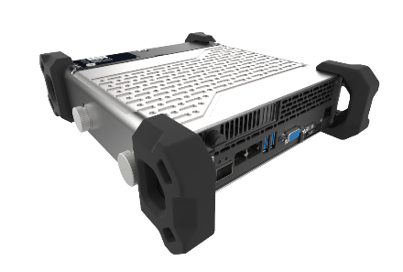
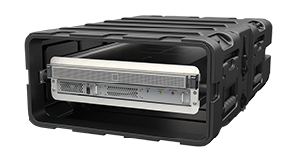
Choose the Appliance Model Best Suited for the Job
Commercial (C) series
Rugged (R) series
Enterprise-ready form factors for use within a traditional business setting
Ruggedized, portable, battery-operated form-factors for harsh field conditions
Intel Arria 10 FPGA
Nvidia T4 GPU
Now available
Preview
Preview

Slide 35


Sunrise Technology, a division of Kroger, uses Azure Stack Edge to enhance Retail-as-a-Service platform
Live video analytics on Azure Stack Edge at the retail stores
Enables personalized and guided shopping experiences such as at-shelf product recommendations
Improves employee productivity by identifying out-of-stocks quickly

Slide 36
Intelligent Retail Blueprint

Slide 37

`
SIZE S M L
COLOR
GREEN
PRICE
$123.45
Customer
Customer
Customer takes apparel off shelf
Smart Mirror uses AR to render apparel looks
Realtime footfall metrics are available in the in-store app
Customer walks into the store. Cameras detect.
CHECK OUT
With an opt in for recognition

Slide 38

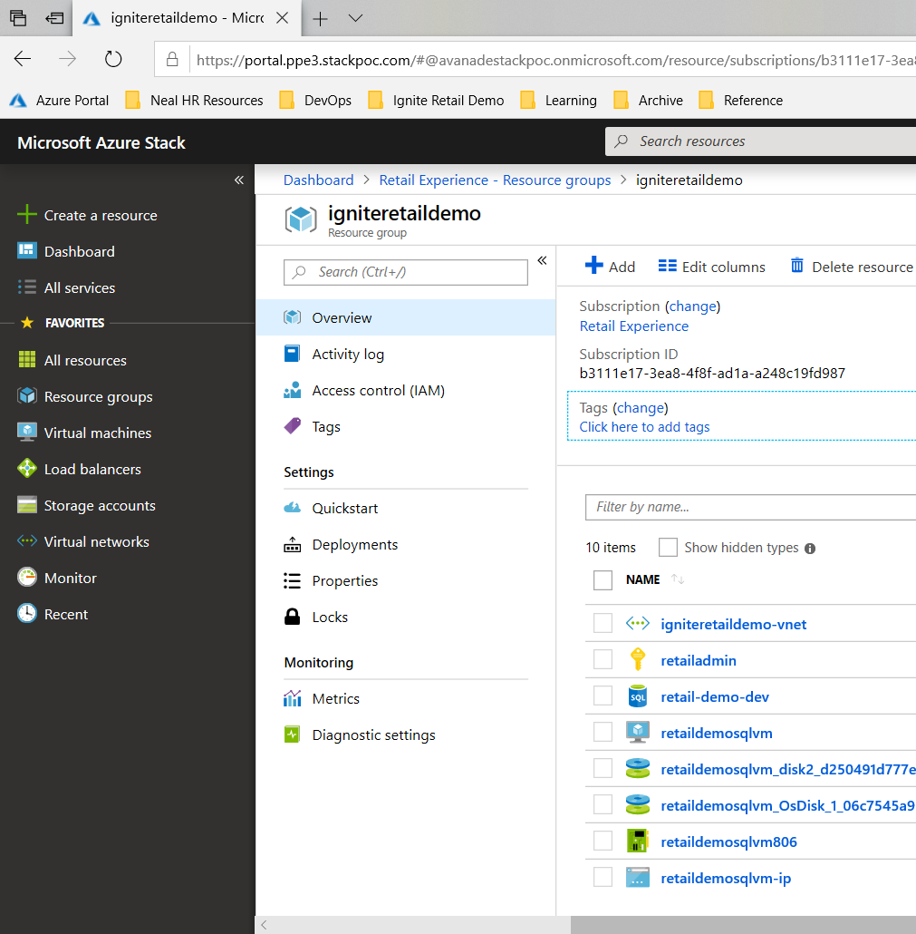
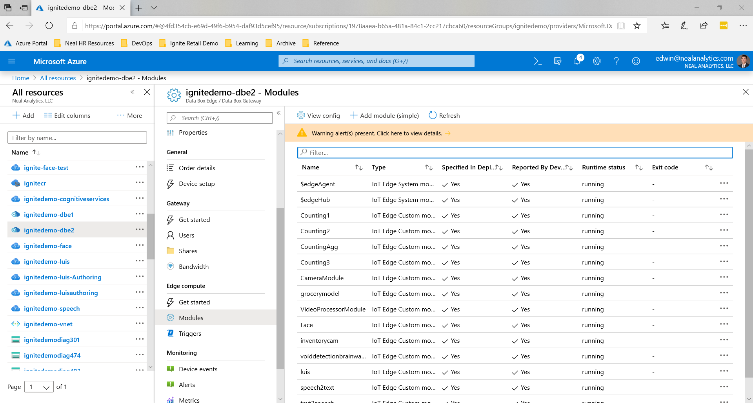
How it works
Azure Stack & Hub management

Slide 39
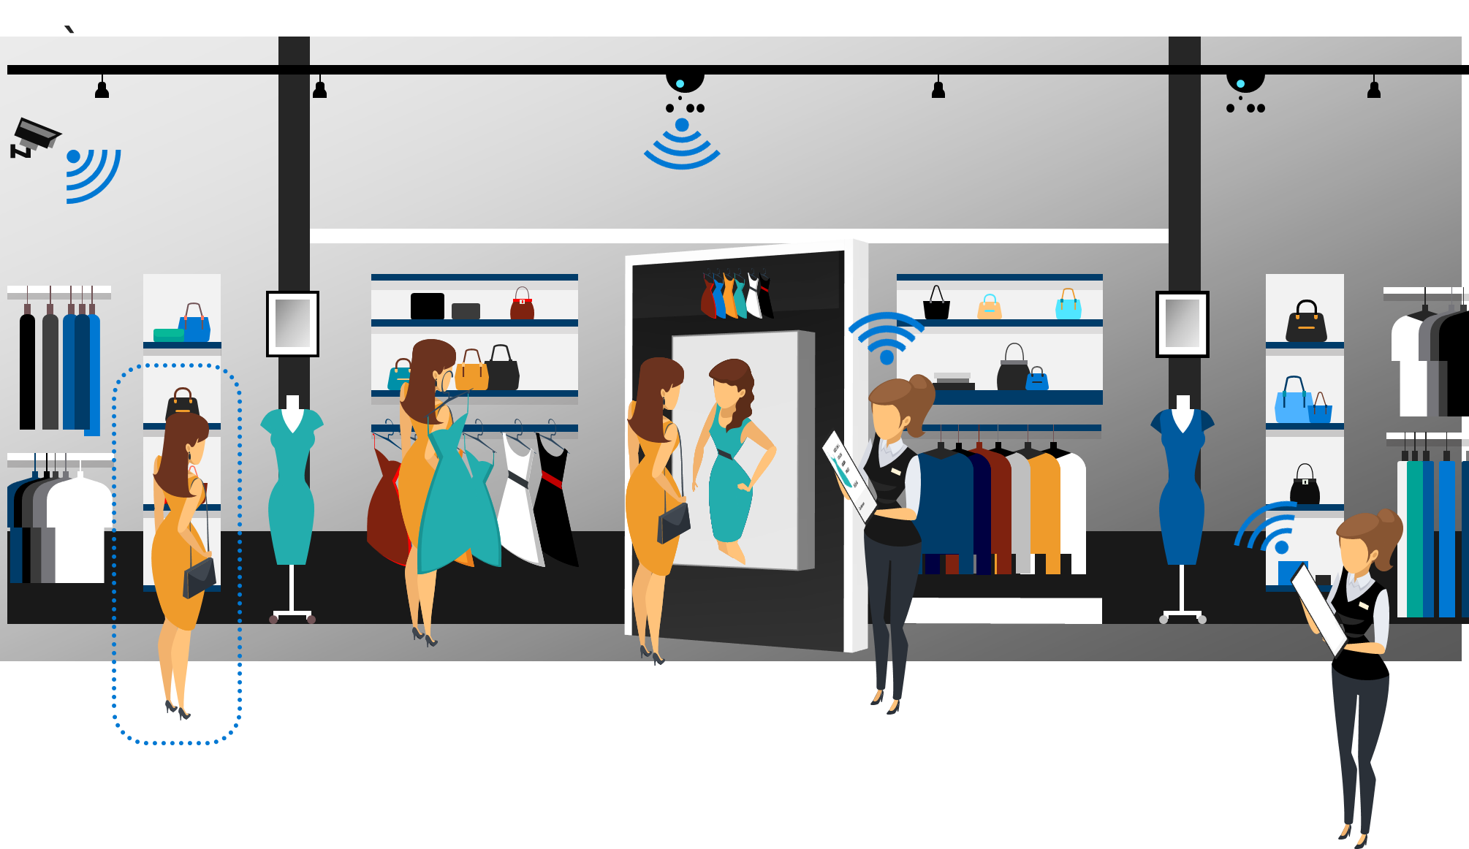
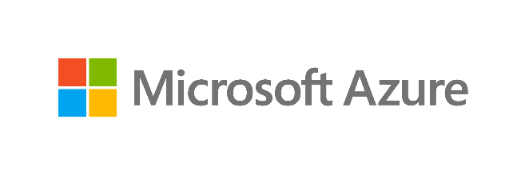





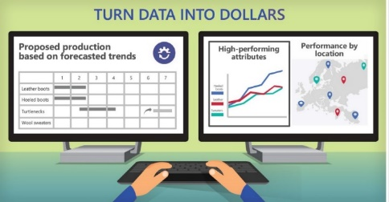

Intelligent edge in action
Capability showcase | shopper insights
EDGE
AZURE STACK EDGE
CLOUD
CLOUD
Data Storage
Aggregation
Data Storage
Aggregation
IoT Edge
Runtime
Cognitive
Services
Azure ML
Azure ML
IoT Hub
IoT Hub
Intel Xeon Processors
Intel Xeon Processors, Intel FPGAs, Intel SSDS
Intel Xeon Processors

Slide 40
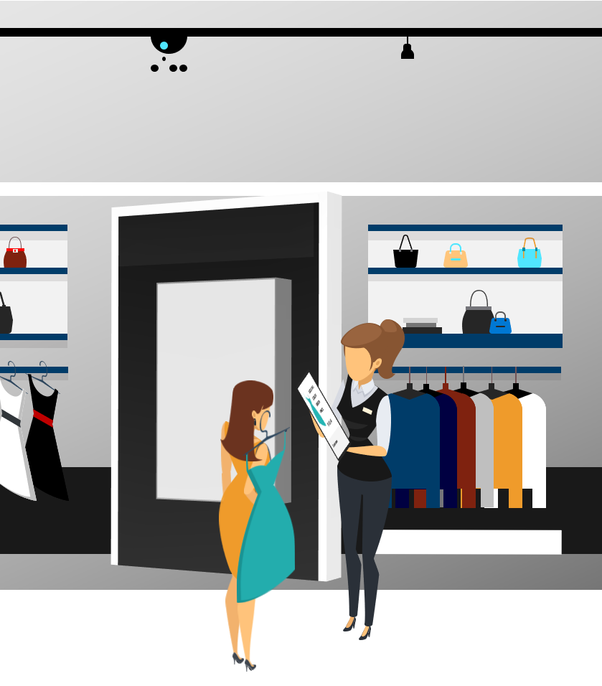
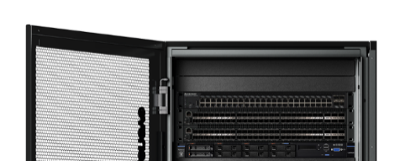
Intelligent edge in action
Capability showcase | smart experiences
EDGE
AZURE STACK EDGE
CLOUD
Data Storage
Aggregation
IoT Edge
Runtime
Cognitive
Services
Intel Technologies
Azure ML
Azure Stack Hub
IoT Hub
Welcome back, Jeri
You look happy.
Data is kept on-premises at a Regional Locations
Powered by Intel Xeon Processors
Intel Xeon Processors

Slide 41
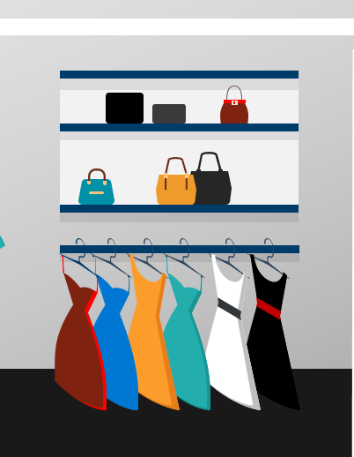
Intelligent edge in action
Capability showcase | improved availability & loss prevention
EDGE
AZURE STACK EDGE
CLOUD
Data Storage
Aggregation
SIZE S M L
COLOR
GREEN
PRICE
$123.45
IoT Edge
Runtime
Cognitive
Services
Customer
Azure ML
Customer
Clerk Notified
IoT Hub
Intel Xeon Processors, Intel FPGAs, Intel SSDS
Intel Xeon Processors

Slide 42
Thank you.

